Slide 1
Post-doc opening
SENIOR RESEARCH OFFICER
Department of Psychology, University of Essex, UK
Ray Meddis (rmeddis@essex.ac.uk) is looking for a post-doc to assist on a project to
design and evaluate new hearing aid algorithms.
The overall aim of the project is to use computer models of normal and impaired hearing
to improve hearing aid design with particular reference to hearing speech in noisy backgrounds.
The project is at an advanced stage and is currently focussed on evaluating aid performance
using automatic speech recognition technology.
The successful applicant will have MATLAB programming skills and knowledge of
automatic speech recognition techniques.
The project is funded by the EPSRC for 18 months. The successful applicant can begin as soon as possible.
Salary: £29,853 per annum
More information: http://gs12.globalsuccessor.com/fe/tpl_essex01.asp?newms=jj&id=50616
Closing date: 27/05/10

Slide 2
Essex Hearing Dummy Project
Ray Meddis
Dr. Wendy Lecluyse
Dr. Robert Ferry
Christine Tan
Manasa Panda
Dept. of Psychology, University of Essex
Oldenburg May 2010

Slide 3
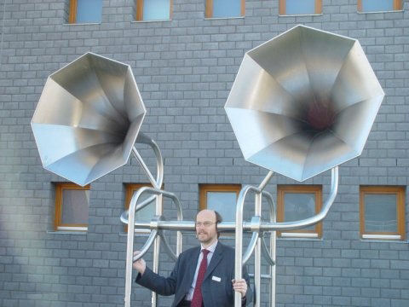
Thank you for inviting me

Slide 4
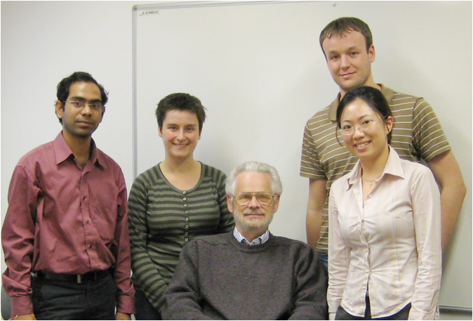
Manasa Wendy Ray Robert Christine
Panda Lecluyse Meddis Ferry Tan

Slide 5
The project...
Aims:
To use a computer model to represent
normal hearing
individual cases of impaired hearing
Medium term aim:
to use the model to assess hearing aids

Slide 6
Proposed scheme
Make patient measurements
Generate individualised computer model for that patient
Simulate hearing aid
Assess impact of the aid

Slide 7
Measurements
Absolute thresholds
  audibility is crucial
Iso-forward masking contours (IFMCs)
  Reveal the extent to which tones at different frequencies interfere with one another
Temporal masking curves (TMCs)
  Reveal patterns of compression

Slide 8
Profile example: very good hearing
CMa-left, male, age 21 yrs
250 Hz 500 Hz 1000 Hz 2000Hz 4000Hz 6000Hz
100
50
TMC
IFMC
500-ms
threshold
90
0
0
0.1
gap (s)
70
50
threshold (dB SPL)
30
10
-
10
100
1000
10000
masker frequency (Hz)

Slide 9
absolute threshold task:
90
70
50
30
10
100
1000
10000
probe frequency (Hz)
cue test
(easy to hear) (hard to hear)
+10 dB SL
time →
cue probe test probe
task: count the number of probes you hear (1/2)

Slide 10
NB single-interval procedure count the number of probes you hear (1/2)
cue test
(easy to hear) (hard to hear)
+10 dB SL
time →
cue probe test probe
cue is same as test probe
(only louder)
response ‘1’ means ‘NO’
response ‘2’ means ‘YES’
(the probe is always audible)

Slide 11
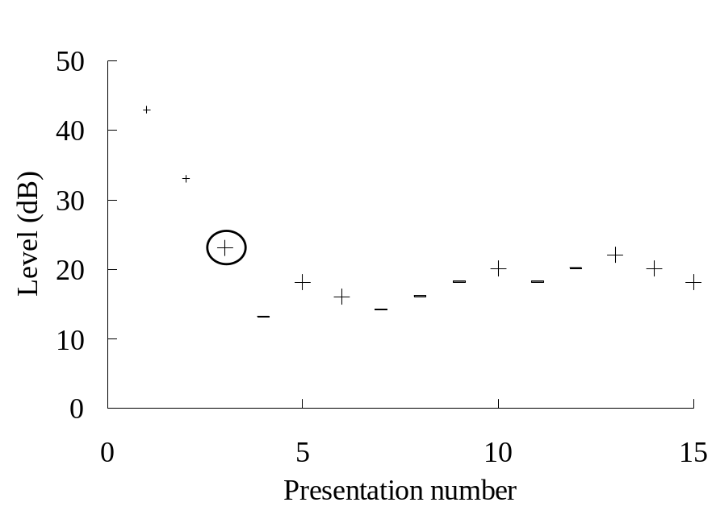
Single interval up/down method
Very fast (around 1 min per threshold estimate)
Only ten trials after first reversal.
Fully automated

Slide 12
IFMC (iso-forward masking contour) task: count the number of probes you hear (1/2)
cue test
(easy to hear) (hard to hear)
f_{m1}
f_{m1}
+10 dB SL (both probes)
time →
masker probe
90
70
f_{p}
f_{p}
50
f_{m2}
30
f_{m2}
masker level (dB)
10
-10
variable frequency
100
1000
10000
masker frequency (Hz)

Slide 13
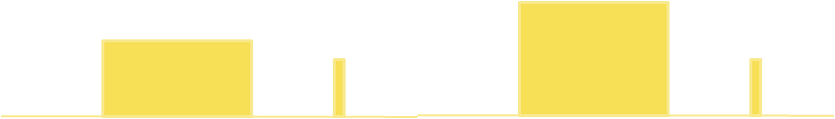
TMC (temporal masking curve) task: count the number of probes you hear (1/2)
cue test
(easy to hear) (hard to hear)
+10 dB SL (both probes)
time →
masker probe
masker dB
variable gap
0 gap 100ms

Slide 14
Details
Absolute threshold
  500-ms pure tone
IFMC
  108-ms masker with 8-ms probe (10 dB SL)
  gap 10-ms. Masker frequency is varied
TMC
  108-ms masker with 8-ms probe (10 dB SL)
  gaps10-90 ms. Masker and probe have same frequency.
All tests at
250, 500, 1000, 2000, 4000, (6000) 8000 Hz

Slide 15
NORMAL HEARERS, various profiles
CMa
CTa
100
100
90
50
90
50
70
0
0
0.1
70
0
gap (s)
0
0.1
gap (s)
50
50
30
30
10
10
-10
100
1000
10000
-10
100
1000
10000
MPa
MKi
100
100
90
50
90
50
70
0
0
0.1
70
0
0
0.1
gap (s)
gap (s)
50
50
30
30
10
10
-10
100
1000
10000
100
1000
10000
-10

Slide 16
Small dead region
MKi
100
probe frequency
90
50
70
0
0
gap (s)
0.1
50
30
best
masker
frequencies
10
100
1000
10000
-10

Slide 17
IMPAIRED HEARERS, various profiles
CWa
MFr
100
100
50
50
90
90
0
0
0.1
0
gap (s)
70
0
0.1
70
gap (s)
50
50
30
30
10
10
-10
100
1000
10000
-10
100
1000
10000
JEv
JJo
100
100
50
90
50
90
0
0
0.1
0
gap (s)
70
0
0.1
70
gap (s)
50
50
30
30
10
10
-10
100
1000
10000
-10
100
1000
10000

Slide 18
HF dead region
JJo
100
90
2.5-kHz probe frequency
50
0
70
0
0.1
gap (s)
50
30
best
masker
frequency
10
100
1000
10000
-10

Slide 19
Purpose of the exercise
We are collecting data to be simulated by an individualised computer model
because we are interested in the underlying pathology that explains the data pattern

Slide 20
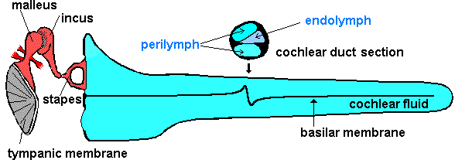
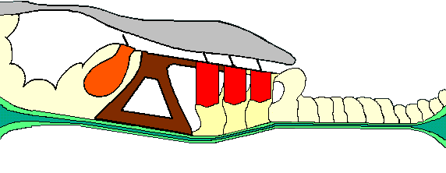

Computer model
pure tone stimulus
stapes
BM motion
IHC stereocilia
receptor potential
transmitter release
AN action potentials
(20 fibers)

Slide 21
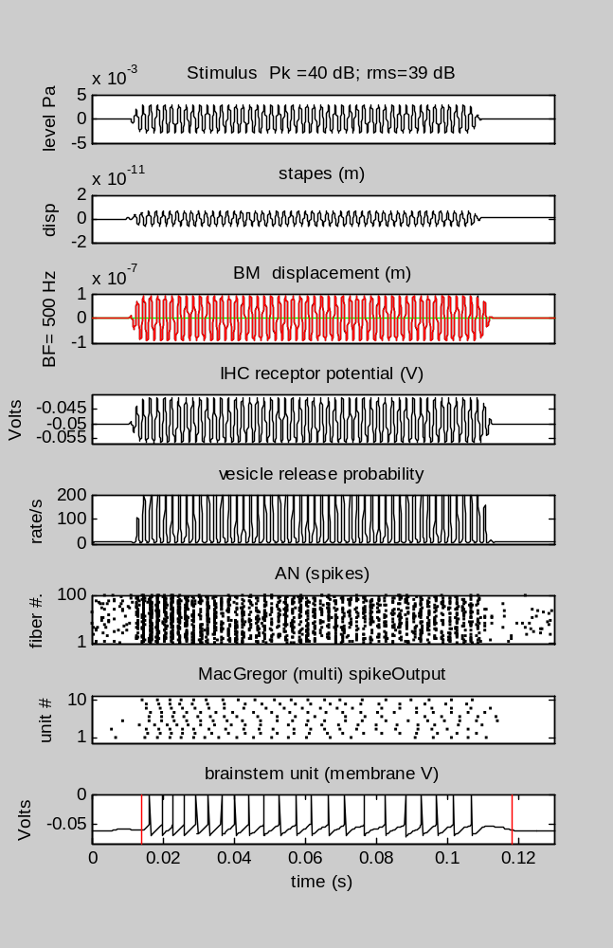
Stimulus is above threshold if at least one spike occurs

Slide 22
Evaluating the model
The model is tested using exactly the same procedures as the patients
absolute thresholds
Iso-forward masking contours (IFMCs, PTCs)
Temporal masking curves(TMCs, compression)

Slide 23
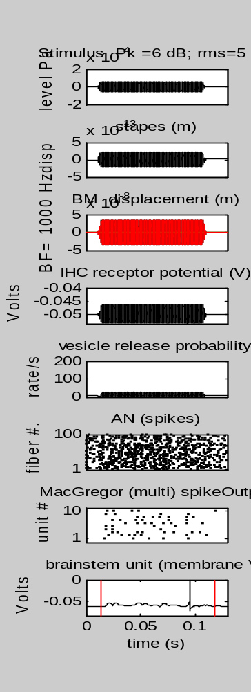
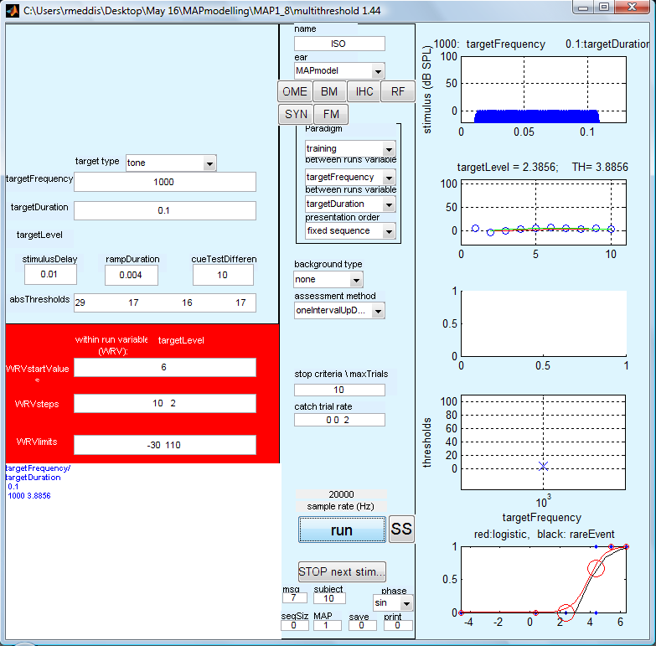
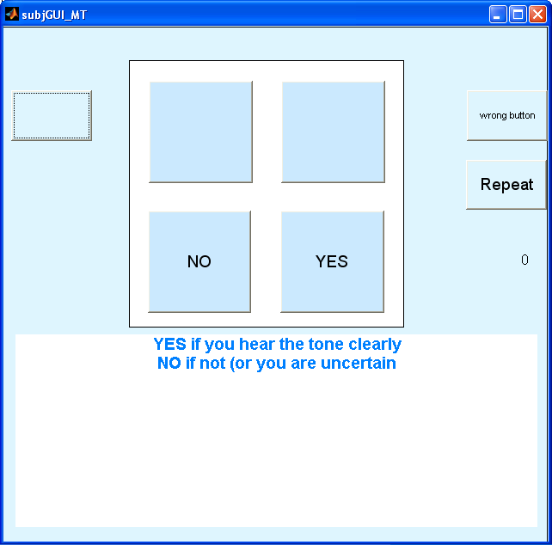
Collecting the data with the model
audiologist model
model makes the decisions and presses the buttons

Slide 24
Very good hearing (model CMa)
90
70
50
30
10
100
1000
10000

Slide 25
Very good hearing (data CMa)
100
50
90
0
0.1
0
gap (s)
70
50
30
data CMa-left
10
100
1000
10000
-
10

Slide 26
model (CMa) data
100
1000
10000
-
100
1000
10000

Slide 27
Sensory-neural hearing loss (JEv)
100
50
90
0
0
0.1
gap (s)
70
50
no conduction problems
flat loss
presbyacusis
tuning broader but intact
compression present
30
data JEv-L
10
100
1000
10000
-
10

Slide 28
Sensory-neural hearing loss
(JEv model)
90
70
50
normal model (CMa)
with only one
parameter change
Endocochlear potential was reduced from 0.1 to 0.08 V.
NB applied only to IHCs
30
Model(JEv-L)
10
100
1000
10000
-
10

Slide 29
model (JEv) data
0
0.1
100
1000
10000
10
1000
10000
-
-
One parameter change from normal model ( Et: -0.1 to -0.08)

Slide 30
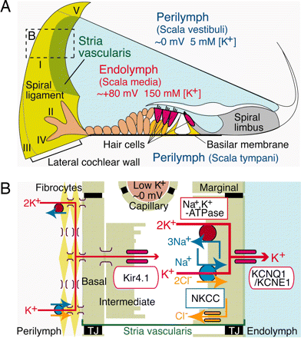
Endocochlear potential (Et)

Slide 31
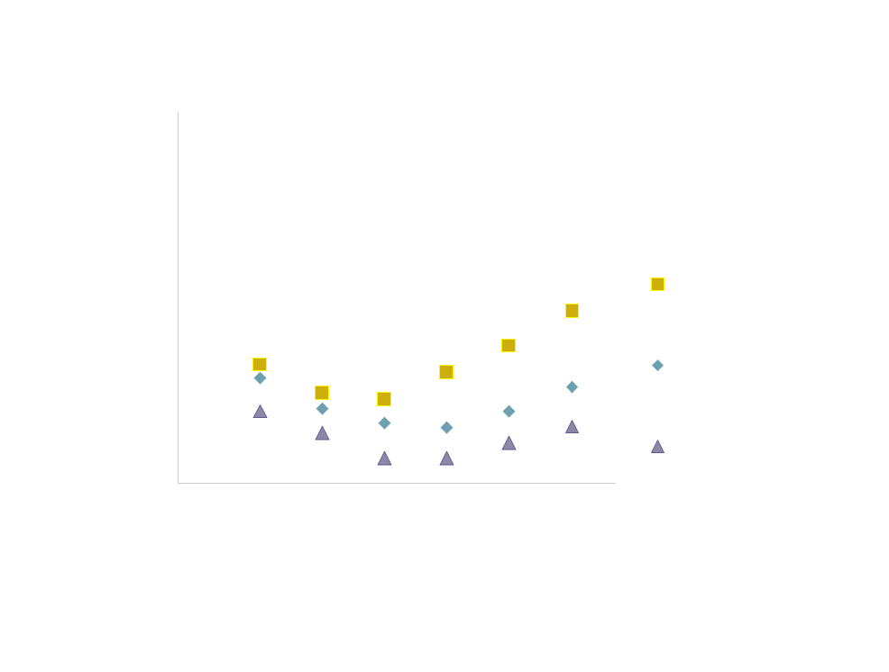
Endocochlear potential
HF thresholds are affected more than LF thresholds when Et is changed.
absolute thresholds
(normal)

Slide 32
Why high frequencies show higher threshold shifts when endocochlear potential is reduced
1 kHz
IHC
voltage
threshold
voltage
8 kHz
normal
impaired
normal
impaired
threshold shift
threshold (dB)
This one explanation as to why old people experience gradual high frequency hearing loss

Slide 33
Sensory-neural hearing loss (CWa)
(no conduction problems)
100
reduced compression
50
90
0
dead HF region
70
50
30
data CWa-R
10
100
1000
10000
10

Slide 34
Sensory-neural hearing loss
(CWa model)
90
70
50
Same model as CMa
(very good hearing)
With only one parameter change
OHC gain reduced
30
Model(CWa-R)
10
100
1000
10000
-
10

Slide 35
model (CWa) data
100
1000
10000
100
1000
10000
OHC gain abolished (DRNL.a=0)

Slide 36
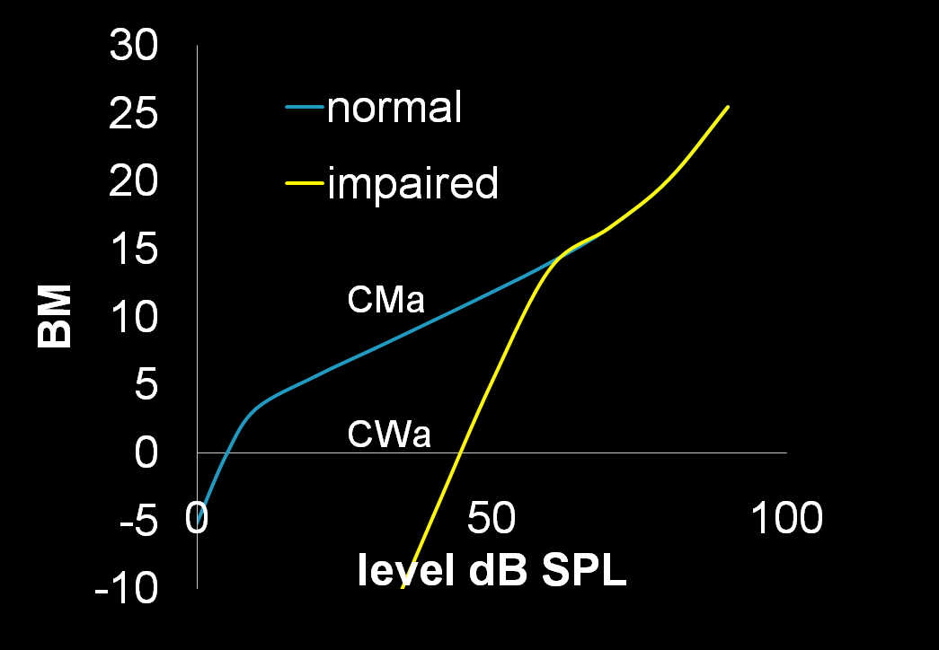
Single parameter change attenuation of BM I/O

Slide 37
Single parameter change may reflect pathology
normal model
(CMa)
normal model
(CMa)
Et reduced
OHC dysfunction
impaired
model
(JEv)
impaired
model
(CWa)
Model(JEv-L)
Model(CWa-R)
-
-

Slide 38
Current research
Using a computer model to
assess hearing aids
  using automatic speech recognition

Slide 39


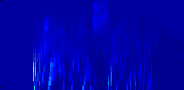
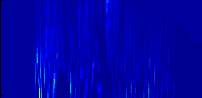
Designing a hearing aid algorithm
Hearing aid algorithm
impaired
model
normal
model
impaired
model
Auditory nerve
response
20 channels
250 : 10000 Hz
Which impaired response is the most informative?

Slide 40
Conclusions
Hearing impaired patients show considerable variability
Individualised models can be generated from normal models with single parameter change
Models may soon be good enough to use for optimising hearing aids for a single patient.

Slide 41
Thank you

Slide 42
Manasa Panda (data)
MPa-L
250 Hz 500Hz 1000 Hz 2000Hz 4000Hz 6000Hz
TMC
IFMC
500-ms
threshold
90
70
masker threshold (dB SPL)
50
30
10
100
1000
10000
-
10
masker frequency (Hz)

Slide 43
Manasa Panda (model)
Model(MPa-L)
250 Hz 500Hz 1000 Hz 2000Hz 4000Hz 6000Hz
-
100
50
90
0
70
0
0.1
gap (s)
50
masker threshold (dB SPL)
30
10
100
1000
10000
-
10
masker frequency (Hz)

